Slide 1


Basic Java Refresher
ITP64 Integrative Programming and Technologies 1

Slide 2
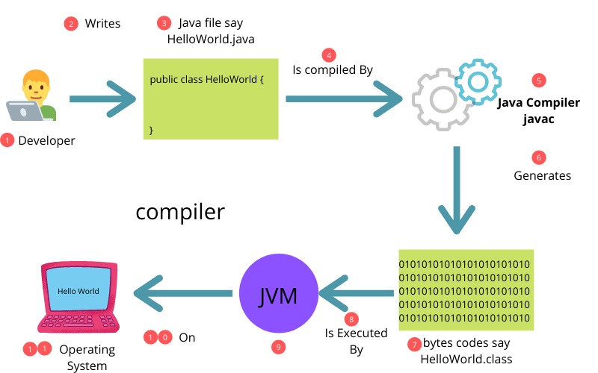
How Java Works

Slide 3
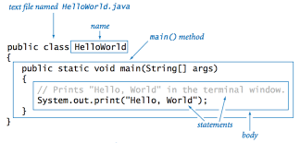
Java Program Structure

Slide 4
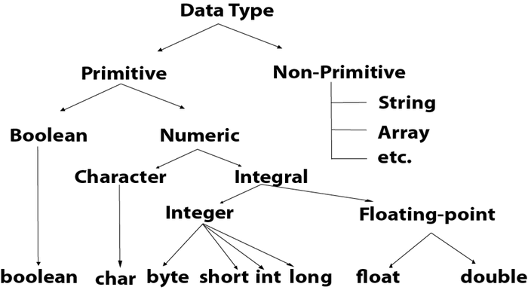
Java Data Types

Slide 5
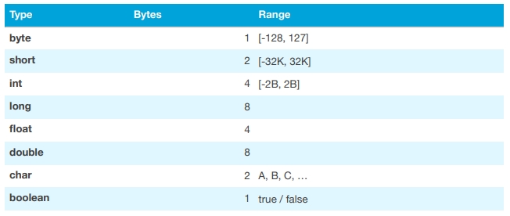
Java Primitive Data Type

Slide 6
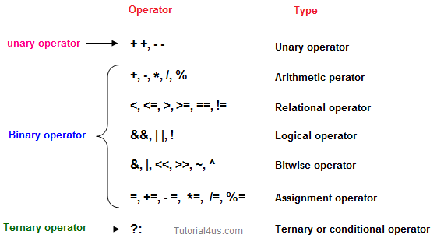
Java Operators and Precedence

Slide 7
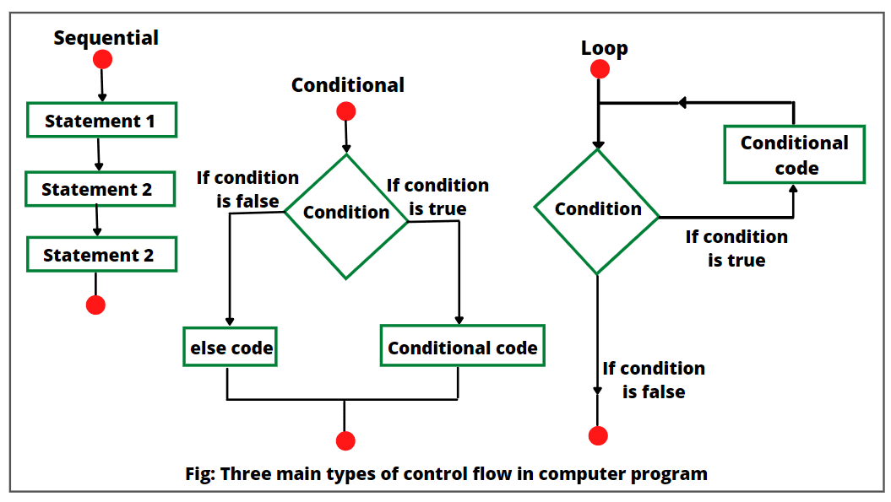
Control Structures

Slide 8
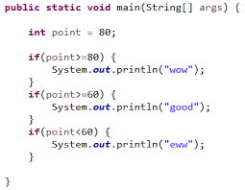
Conditional
Control Structures

Slide 9
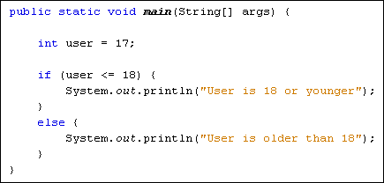
Conditional
Control Structures

Slide 10
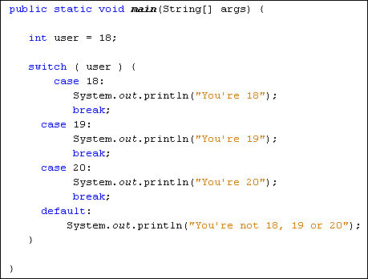
Conditional
Control Structures

Slide 11
for(int i=1; i<=input; i++) {
sum = sum + i;
}
Repetitive Control Structure

Slide 12
int i=1;
while(i<=input) {
sum = sum + i;
i++;
}
Repetitive Control Structure

Slide 13
int i=1;
do {
sum = sum + i;
i++;
} while(i<=input);
Repetitive Control Structure

Slide 14
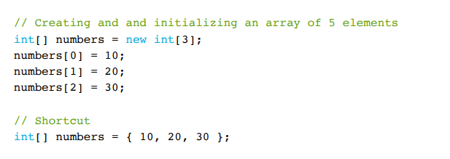
Arrays

Slide 15
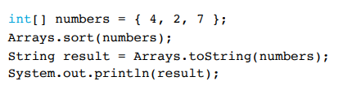
Array Class

Slide 16
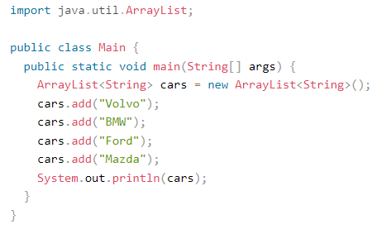
Array List

Slide 17
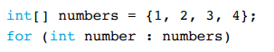
for-each Loop

Slide 18
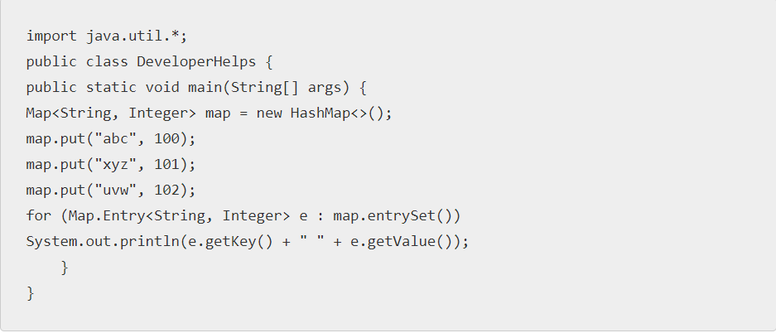
Maps

Slide 19
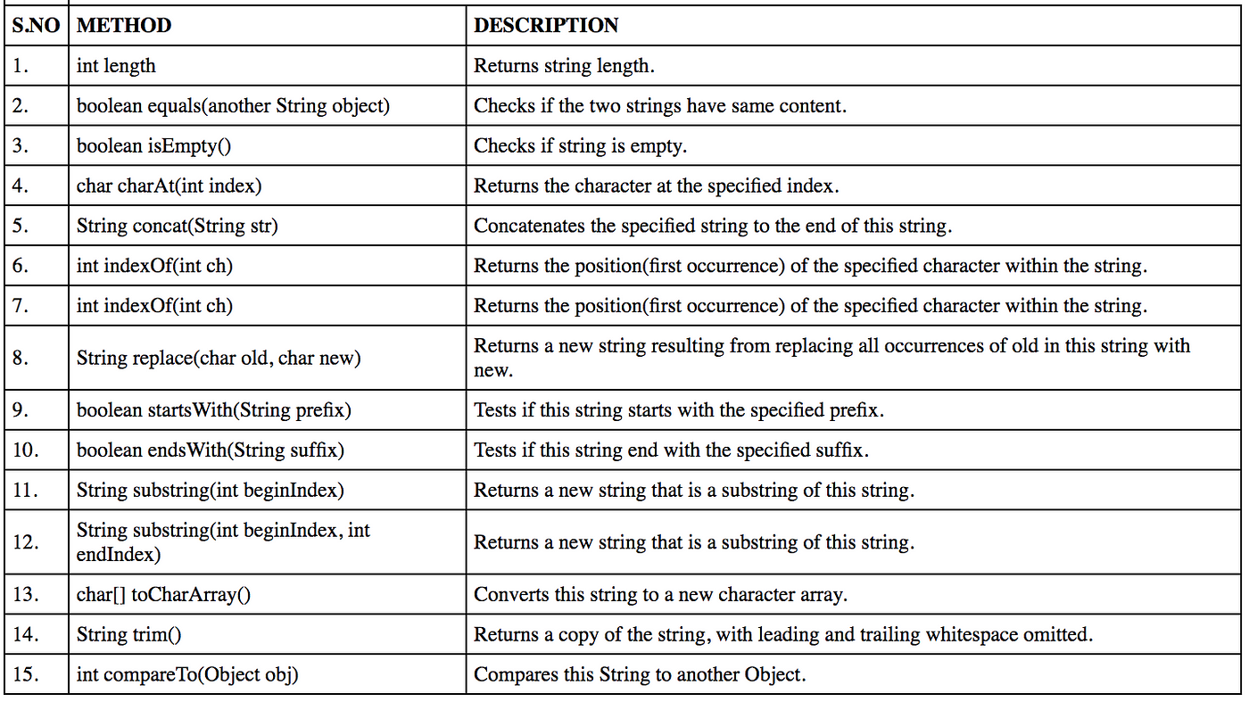
String
String name = “John”;

